Slide 1

C Structures
Data Structures
Dr. Bouchaib Falah

Slide 2
Objectives
To distinguish structures from other C types and motivate their use
To define structure types
To be aware that there are different ways of doing so
To declare and initialize variables of structure types
To access members of structures in order to read and write their values
To pass structure types as parameters
By reference and by value
To return structure types as results
To use structures as parts of other data types
Including other structures and arrays

Slide 3
Structures and Other Data Types
Data types you have seen so far:
Simple: int, double, float, char
Structured: arrays, strings
Structures:
A new derived data type / data structure
Used a lot! (Stacks, Queues, Linked Lists,Trees, ..)
Why a need for such a new data type?

Slide 4
Why Structures?
Need to aggregate data of different types
Arrays: gather data elements of the same data type (homogeneous)
Structures: gather data elements of different types (heterogeneous)
In the C language structures are used to group together different types of variables under the same name.
C/C++ structures are called records in some other languages.
A typical use of structures is representing database records

Slide 5
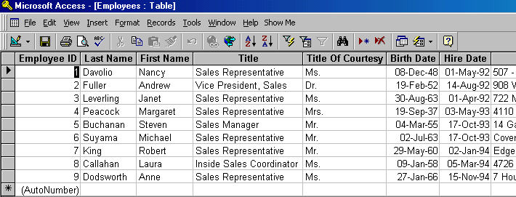
Databases
A DB/Table is composed of a set of records (rows).
Each record contains a set of fields (columns).
So, to implement a DB you need a data type that can gather elements of different types.
Fields
Records

Slide 6
Defining Structures: Syntax (1)
typedef struct {
data_type_1 member_1;
data_type_2 member_2;
...
data_type_n member_n;
} struct_name;
struct_name Var_1, Var_2;
var_1 & var_2 are two variables of type struct_name
Def: Members  elements of a structure
Also use records for structures and fields for members (terminology used in DBs and other PLs )

Slide 7
Example
typedef struct {
char name[20];
int credits_num;
double g1, g2, g3;
char grade;
} student;
student x, y;
 student has become a regular data type!

Slide 8
Defining Structures: Syntax (1)
struct allocates no memory
It just defines a “template”
Memory is allocated after declaring specific variables.
Ex. student x, y;
x & y will have the same amount of memory space allocated as they are of the same data structure (data type).
typedef gives the template a name

Slide 9
Actually … there are a few more ways to define structures

Slide 10
Defining Structures: Syntax (2)
It is possible to declare a structure without a name:
struct {
int a, b;
} var1, var2;
but it is not very useful....

Slide 11
Defining Structures: Syntax (2)
It creates incompatible types unless the vars are declared on the same line, even if the types are structurally identical.
struct {
int a, b;
} var1, var2;
struct {
int a, b;
} var3;
…
var1 = var2; // okay
var3 = var1; // ERROR

Slide 12
Defining Structures: Syntax (3)
So, give the structure a name: a compound name
struct mystruct1 {
int a; char b;
};
struct mystruct1 var1;
struct mystruct1 var2;
var1 = var2; // this is okay
struct mystruct2 {
int c; char d;
} var3;
struct mystruct2 var4;
var3 = var4; // this is okay too
So, we have to keep using struct mystruct1 or struct mystruct2

Slide 13
Defining Structures: Syntax (4)
Or .. Use both the structure name and typedef
typedef struct mystruct3 {
int c;
char d;
} mystruct_t; // this is a type name
mystruct_t var5;
struct mystruct3 var6;
var6 = var5; // this is okay
var3 = var5; // this is an error (see prev slide)
Here typedef is creating another name for the type already named struct mystruct3. It’s okay but redundant.

Slide 14
Initializing Structures
You can assign values to each member of a structure when you first declare it. E.g.
typedef struct {
char name[20];
int credits_num;
double g1, g2, g3;
char grade;
} student;
student s1 = {"Ann Ying", 60, 80.0, 75.5, 92.0, 'B'};

Slide 15
Assigning to members of structures
You can assign to members of structures with a normal assignment statement, e.g.
typedef struct {
char name[20];
int credits_num;
double g1, g2, g3;
char grade;
} student;
student s1; s1.g1 = 90.5;

Slide 16
Assigning to members of structures
To access the members of the structure, we must use a dot between the structure name and the variable name if the variable is not an array: Structure’s Variable. Member’s Name
EXCEPTION: When the member is an array of character, you cannot assign to it. You must use strcpy(…) in <string.h>, e.g. strcpy(s1.name, “John Doe”);

Slide 17
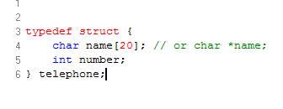
Example: Create a Structure
Create a structure “telephone”: which is made up of a string (that is used to hold the name of the person) and an integer (that is used to hold the telephone number).

Slide 18
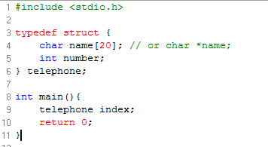
Example: Create a Structure Variable
Write the main function in which you create a variable, index, of data structure, telephone.

Slide 19
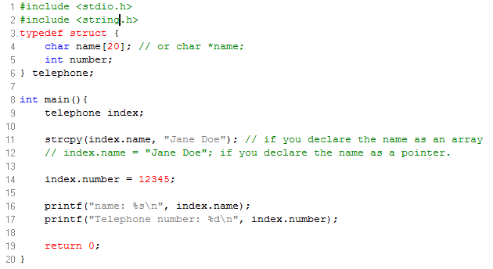
Example: Access Structure Members
Assign the person’s name to “Jane Doe” and the telephone number to 12345 and then print the name and the phone number

Slide 20
Exercise_1
Write a program that prompts the user to input the current month (as text), day, year.
Store the data entered in a suitably defined structure called date_t and display the date in an appropriate format (Ex: 27-February-1880)
write the structure definition
declare the variable
write the main function to input the values and output them

Slide 21
Hierarchical structures
Structures can be members of other structures.
Example:
typedef struct {
double midterm;
double final;
char grade;
} grade_t;
typedef struct {
char name[20];
grade_t gr;
} student;
student s;
To access the member “final”:
s.gr.final

Slide 22
Exercise_2
Define a structure type called time_t to store a time using integer members hours, minutes and seconds. Use 24-hour time.
Define a structure called event_t that includes as members:
event_name: a string
date: a date_t (The one used in Exercise 1)
time: a time_t
Write the main function to input values for all members and print out what was entered.

Slide 23
Structures as Input/Output Parameters (1)
Can be passed by Value or by reference
Passed By Value:
void print(student S) {
printf(“Name: %s\n Grade: %c”, S.name, S.gr.grade);
}
student s1;
print(s1);

Slide 24
Structures as Input/Output Parameters (2)
Passed by Reference:
void fill_up(student *S) {
printf(“Enter Name & GPA: ”);
scanf( “%s %c”,
(*S).name, &(*S).gr.grade);
}
student s1;
fill_up(&s1);
NOTE: S.name is an array. No & needed.

Slide 25
Pointers and Structures
Exs: (*S).name, &(*S).gr.grade;
*S means that the pointer to S is being dereferenced, that is, we are using the address stored in the pointer variable to access the value stored at that address.
The parentheses around *S make sure that the pointer S is dereferenced first, before applying the dot operator to access the member
Alternative Notation: S->member is equivalent to (*S).member

Slide 26
Exercise_3
Write a program that would fill up two student records, swap them, then display them again.
 Use three functions:
fill_up
swap
display
 Use a student structure that contains a name string and a double GPA

Slide 27
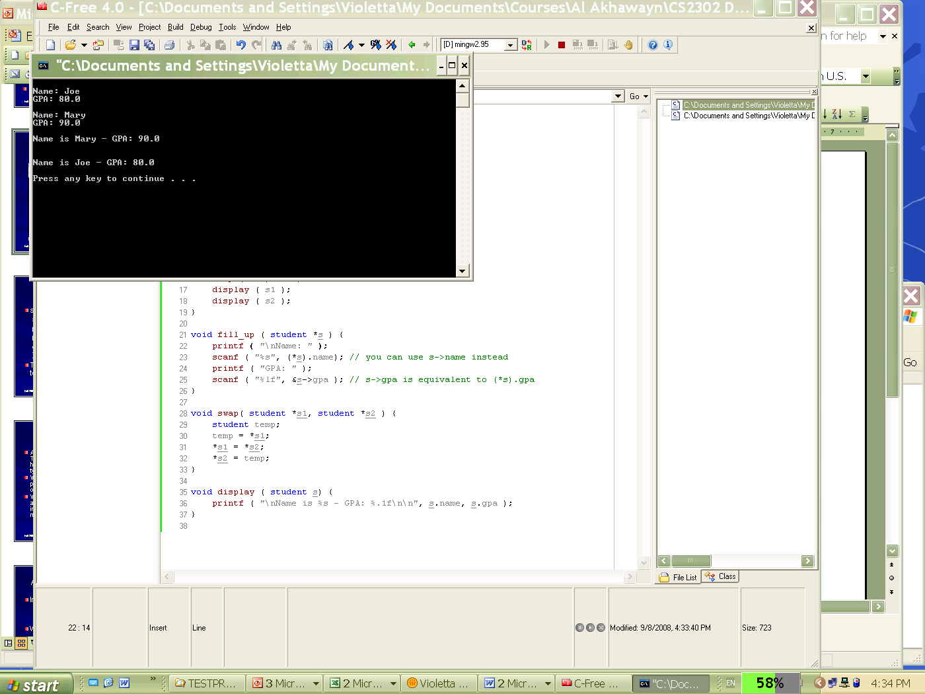
Exercise_3 Output: Contents are swapped

Slide 28
Pointers and Structures
A closer look at swap:
// declare temp
student temp;
// dereference s1, assign its contents to temp
temp = *s1;
// dereference s2, assign its contents to s1
// after dereferencing s1
*s1 = *s2;
// dereference s2, assign to it the contents
// of temp (old s1)
*s2 = temp;

Slide 29
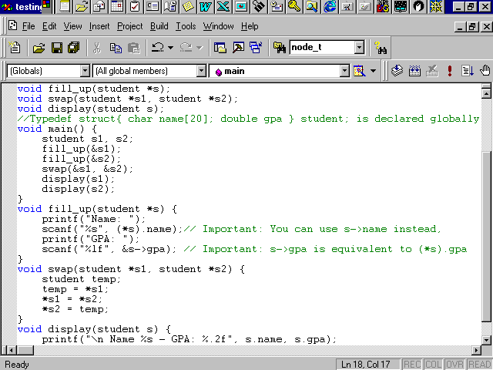
Exercise_3 Solution

Slide 30
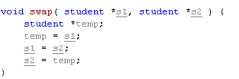
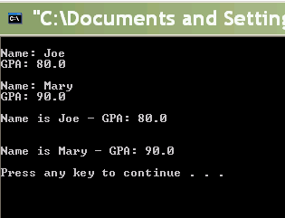
Exercise_3: someone asked “Why not just swap pointers?”
This obviously doesn’t do what we want it to.
But what does it do?

Slide 31
Exercise_3 modified: Explanation
At the start of swap:
s1 == address of s1 structure in main
s2 == address of s2 structure in main
In swap:
temp = s1 : temp == address of s1 struct in main
s1 = s2 : s1 == address of s2 struct in main
s2 = s1 : s2 == address of s1 struct in main
But... these changes happen only locally:
The pointers themselves are being treated as local variables (passed in by value)
Since no dereferencing is happening, nothing outside swap is affected.

Slide 32
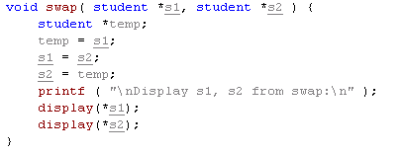
Exercise_3 modified: How do we know?
Try displaying the structs that s1 and s2 point to right before exiting swap:

Slide 33
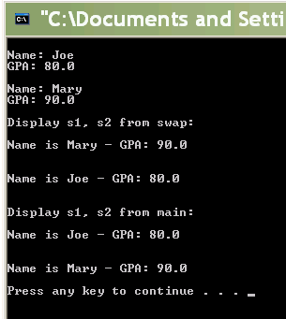
Exercise_3 modified: Evidence
Swapped in swap
Not swapped in main

Slide 34
Structures as return values
A value of struct type can be returned from a function
Like simple data types
Unlike arrays
Rewrite the fill_up function (see below) with the student record as a returned parameter.
void fill_up( student *s) {
printf(“Name:); scanf(“%s”, s->name);
printf(“GPA:); scanf(“%lf”, &s->gpa);
}

Slide 35
Structures as return values: Solution
student fill_up( ) {
student s;
printf(“name:”); scanf(“%s”, s.name);
printf(“gpa:”); scanf(“%lf”, &s.gpa);
return s;
}
Then you can fill students like so:
S1 = fill_up( );

Slide 36
Arrays of Structures
Assume you have a structure type:
typedef struct {
char name[20];
double salary;
int rank;
} employee_t;
An array of employees’ structures is declared:
employee_t emp_array[ MAX ];
Accessing elements:
emp_array[e].salary = 7000;
emp_array[e].name[0];

Slide 37
Using typedef with Arrays
General syntax of typedef is: typedef typedefinition typename;
Examples:
typedef struct { … } student; // name the type
With arrays it’s a bit different: typedef basetype typename [ size ];
Example:
typedef int intarray10 [10];
typedef employee_t employeearray_t [ MAX ];

Slide 38
Exercise_4
A straight line is an object connecting two points. Therefore, a line can be represented by a hierarchical structure having two structures of type point (the beginning and the end):
QUESTION: What should these two structure definitions look like (for line and point)?
Write a function called get_line that accepts two parameters of type point and returns a structure of type line representing that line.
Write another function called check_line that accepts a parameter of type line and returns an integer (1, 2, or 3, where 1 means vertical, 2 means horizontal, and 3 means oblique).

Slide 39
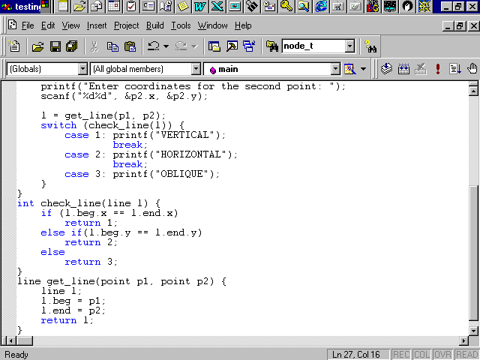
Exercise_4 Solution

Slide 40
Summary
C structures:
Are a user-defined type
Can be named using typedef
Gather together different types of data
simple built-in or user-defined types, arrays, and other structures
Can be used as the base element type of arrays
Can be used as members of other C structures
Can be accessed/modified through their members using the dot operator.
Can be assigned to variables or memory locations of the same structure type
Can be passed as parameters by reference/value
Can be returned as values of functions
C structures and arrays give you a lot of power in organizing data since you can embed them into each other almost indefinitely but be aware of their size.

